Slide 1

Falcon 9 Landing Analysis: ​ A Data Science Approach at SpaceX​
Asha A Shet, May 31st 2024

Slide 2




OUTLINE
Executive Summary
Introduction
Methodology
Results
Visualization – Charts
Dashboard
Discussion
Findings & Implications
Conclusion
Appendix

Slide 3

EXECUTIVE SUMMARY

Slide 4

Methodologies
Data Collection
Data Wrapping
EDA with Data Visualization
EDA with SQL
Building interactive map with Folium
Building Dashboard with Plotly Dash
Predictive Analysis
Results
Exploratory Data Analysis Results
Geospatial Analytics
Interactive Dashboard
Predictive Analysis of Classification Models

Slide 5
INTRODUCTION

Slide 6
Project Description:
In the burgeoning era of commercial space travel, companies like SpaceX are revolutionizing accessibility to outer space. SpaceX has emerged as a frontrunner with its cost-effective Falcon 9 rocket launches, priced at approximately $62 million, a fraction of the cost compared to other providers. A key driver of this affordability is SpaceX's ability to successfully land and reuse the first stage of the rocket.
This project endeavours to harness predictive analytics to forecast the likelihood of a successful landing for the Falcon 9 first stage. By analysing historical data encompassing various parameters such as flight trajectory, atmospheric conditions, and technical performance, our objective is to develop a predictive model capable of estimating the probability of a successful landing.
• Problems you want to find answers
Correlations between each rocket variables and successful landing rate
Conditions to get the best results and ensure the best successful landing rate
This project will predict if the SpaceX Falcon 9 first stage will land successfully

Slide 7
METHODOLOGY

Slide 8
Data Collection
Data was collected using SpaceX API and web scrapping from Wikipedia.
2. Data Wrangling
Classifying true landings as successful and unsuccessful
3. Perform Exploratory Data Analysis(EDA) using visualization and SQL
4. Perform Interactive Visual Analytics using Folium and Plotly Dash.
5. Perform Predictive Analysis using Classification Models.
Find best Hyperparameter to SVM, Classification Trees and Logistics Regression.

Slide 9
Data collection
Data collection process involved a combination of API requests from SpaceX public API and web scraping data from a table in SpaceX’s Wikipedia.
SpaceX API Data Columns:
Flight Number data, Booster Version, Payload Mass, Orbit, Launch Site, Outcome, Flights, Grid fins, Reused, Legs, Landing Pad, Block, Reused Count, Serial, Longitude, Latitude.
Wikipedia Web Scrape Data Columns:
Flight No, Launch Site, Payload, Payload Mass, Orbit, Customer, Launch Outcome, Version Booster, Booster Landing , Date, Time.

Slide 10
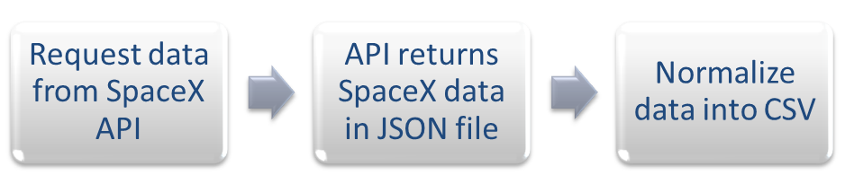

SpaceX API
Web Scrapping

Slide 11
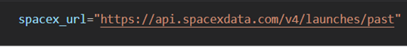
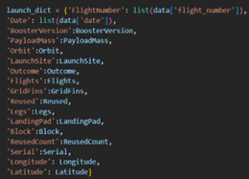
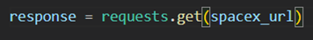
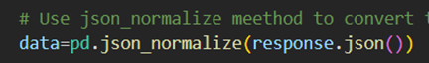
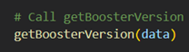
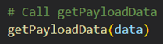
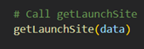
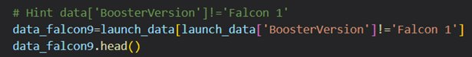
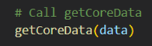
Github Data Collection API
Data Collection-SpaceX Rest API
Make a GET response to the SpaceX API.
Convert the response to a .json file then to Pandas
DataFrame.
3. Using custom functions to clean data
4. Combining the columns into a dictionary to create DataFrame
5. Filter DataFrame to include only falcon 9 launches and reset flight number column

Slide 12
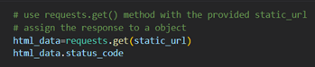
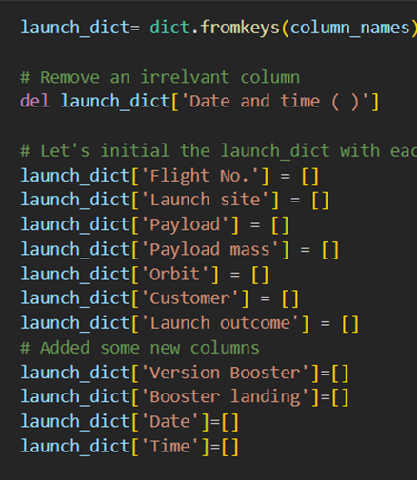
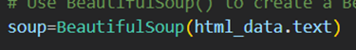
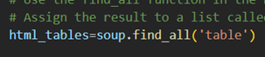
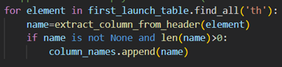
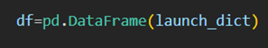
Git Link Web Scraping
Data collection-web scrapping
Getting response from html
Create BeautifulSoup object
Find all tables within the html page
Collect all column header names from the tables
found within html page
5. Create empty dictionaries with keys
6. Convert dictionary to pandas data frame ready to export

Slide 13
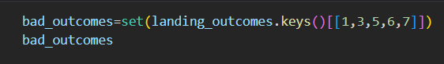
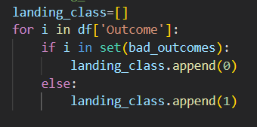
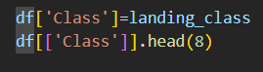
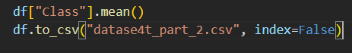
Data Wrangling
Git Link Data wrangling
To determine whether a booster will successfully land, it is best to have a binary column, i.e., where the value is 1 or 0, representing the success of the landing.
This is done by:
Defining a set of unsuccessful (bad) outcomes, bad_outcome
Creating a list, landing_class, where the element is 0 if the corresponding row in Outcome is in the set bad_outcome, otherwise, it’s 1.
Create a Class column that contains the values from the list landing_class
Export the DataFrame as a .csv file.

Slide 14
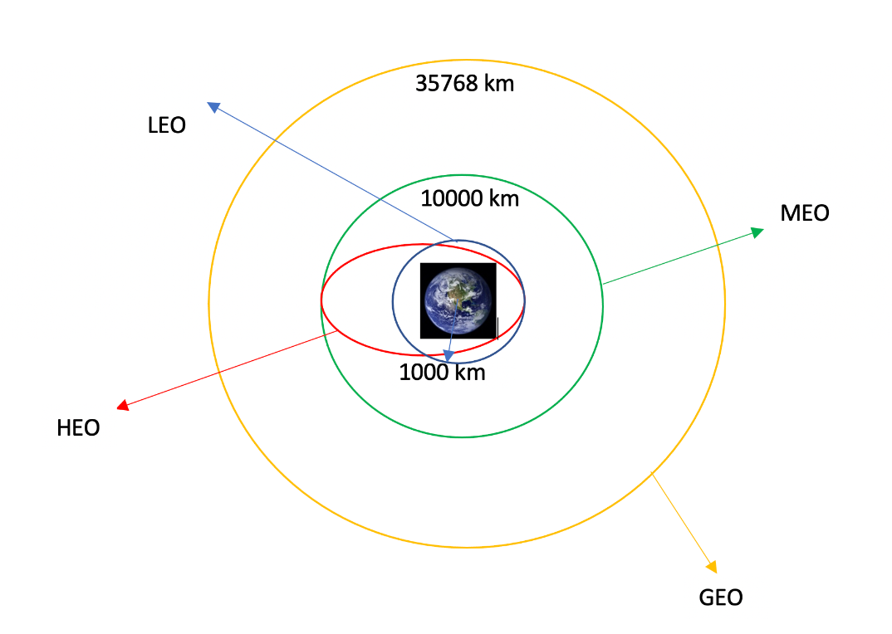
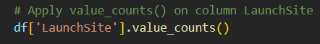
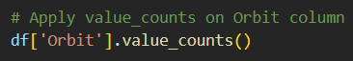
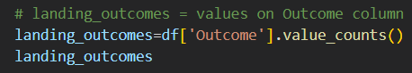
Data Wrangling
The SpaceX dataset contains several Space X launch facilities, and each location is in the Launch Site column. Each launch aims to a dedicated orbit, and some of the common orbit types are shown in the figure below. The orbit type is in the Orbit column.
Git Link Data wrangling
Initial Data Exploration:
Using the .value_counts() method to determine the following:
Calculate the number of launches at each site
Calculate the number and occurrence of each orbit
Calculate the number and occurrence of mission outcome per orbit type

Slide 15
EDA with Data Visualization
Git Link EDA Visualization
SCATTER CHARTS
A scatter plot shows how much one variable is affected by another. The relationship between two variables is called a correlation. This plot is generally composed of large data bodies.
A scatter chart was produced to visualize the relationship between:
○ Flight Number vs. Launch
○ Payload vs. Launch Site
○ Flight Number vs. Orbit Type
○ Payload vs. Orbit Type.
BAR CHARTS
A Bar chart makes it easy to compare datasets between multiple groups at a glance. One axis represents a category and the other axis represents a discrete value. The purpose of this chart is to indicate the relationship between the two axes.
A bar chart was produced to visualize the relationship between:
○ Orbit Type vs. Success Rate
LINE CHARTS
A Line chart shows data variables and trends very clearly and helps predict the results of data that has not yet been recorded.
Line charts were produced to visualize the relationships between:
○ Year vs. Success Rate

Slide 16
EDA with SQL
Git Link EDA SQL
We applied EDA with SQL to get insight from the data. Queries were made to get a better understanding of the dataset.
Display the names of the unique launch sites in the space mission
Display 5 records where launch sites begin with the string ‘CCA’
Display the total payload mass carried by boosters launched by NASA (CRS)
Display the average payload mass carried by booster version F9 v1.1
List the date when the first successful landing outcome on a ground pad was achieved
List the names of the boosters which had success on a drone ship and a payload mass between 4000 and 6000 kg
List the total number of successful and failed mission outcomes
List the names of the booster versions which have carried the maximum payload mass
List the failed landing outcomes on drone ships, their booster versions, and launch site names for 2015
Rank the count of landing outcomes (such as Failure (drone ship) or Success (ground pad)) between the date 2010-06-04 and 2017-03-20, in descending order

Slide 17
Build an Interactive Map with Folium
Git Link Folium Map
The following steps were taken to visualize the launch data on an interactive map:
Objects created and added to a folium map:
○ Markers that show all launch sites on a map
○ Markers that show the success/failed launches for each site on the map
○ Lines that show the distances between a launch site to its proximities.
By adding these objects, following geographical patterns about launch sites are found:
○ Are launch sites in close proximity to railways? Yes
○ Are launch sites in close proximity to highways? Yes
○ Are launch sites in close proximity to coastline? Yes
○ Do launch sites keep certain distance away from cities? Yes

Slide 18
Build a Dashboard with Plotly Dash
Git Link Dash app
The following plots were added to a Plotly Dash dashboard to have an interactive visualisation of the data:
The dashboard application contains a pie chart and a scatter point chart.
Pie chart
For showing total success launches by sites
This chart can be selected to indicate a successful landing distribution across all launch sites or to indicate the success rate of individual launch sites.
Scatter chart
For showing the relationship between Outcomes and Payload mass(Kg) by different boosters
Has 2 inputs: All sites/individual site & Payload mass on a slider between 0 and 10000 kg
This chart helps determine how success depends on the launch point, payload mass, and booster version categories

Slide 19
Git Link predictive analysis
Predictive Analysis – Classification
The following steps were taking to develop, evaluate, and find the best performing classification model:
Perform exploratory Data Analysis and determine Training Labels .
Create a column for the class
Standardize the data
Split into training data and test data
Find best Hyperparameter for SVM, Classification Trees and Logistic Regression
Find the method performs best using test data
Building Model
Evaluating Model
Improving Model
Finding the best performing Classification Model

Slide 20
RESULTS

Slide 21
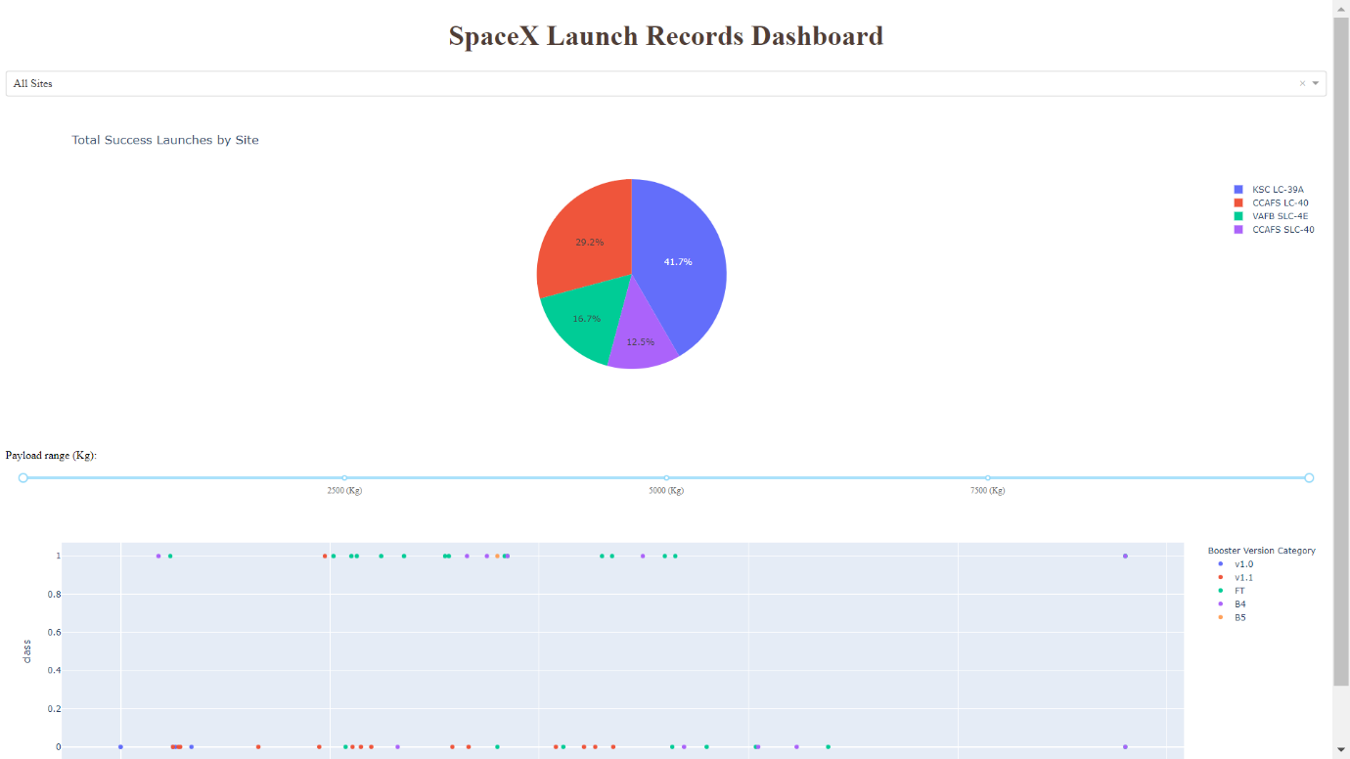
It is a preview of the Dashboard with Plotly Dash.
The results of EDA with visualization, EDA with SQL, Interactive Map with Folium, and Interactive Dashboard will be shown in the next slides.
Comparing the accuracy of the four methods, all return the same accuracy of about 83% for test data.

Slide 22
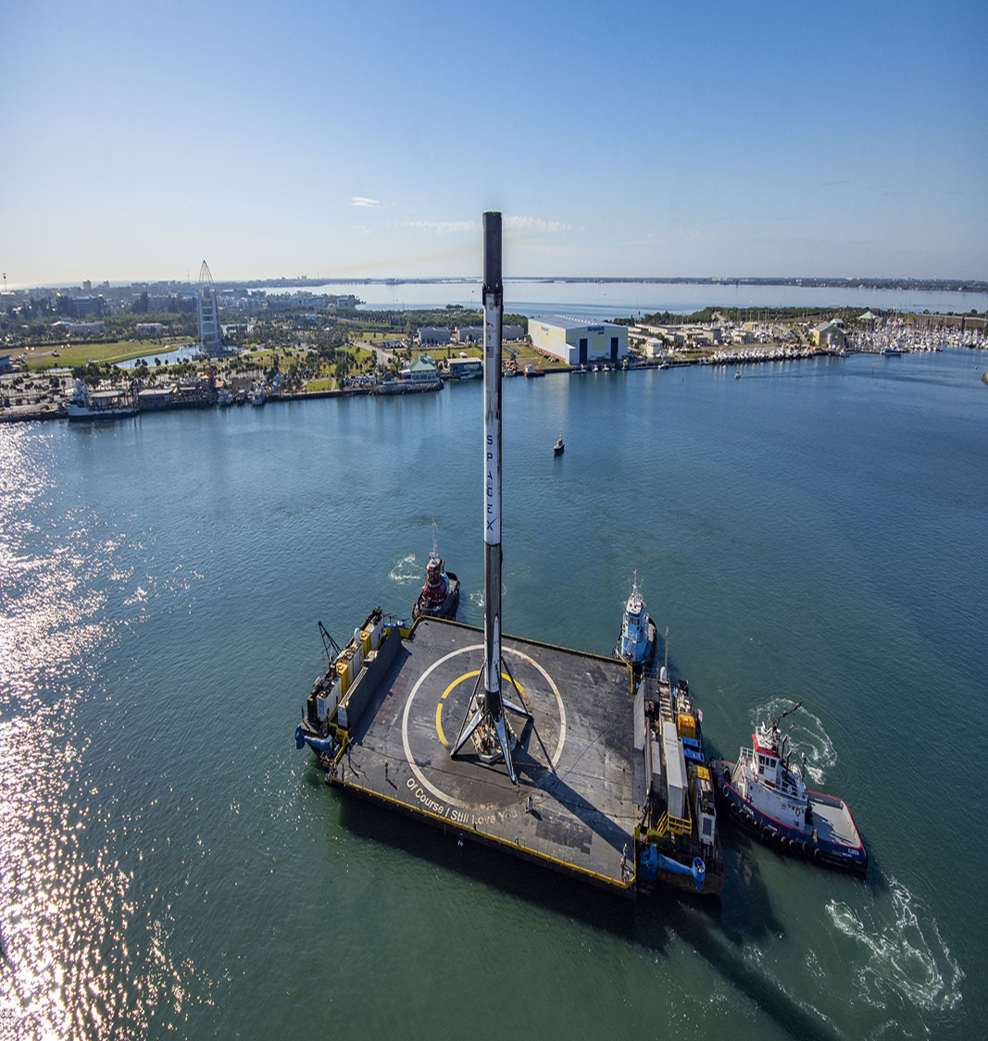
INSIGHTS DRAWN FROM EDA

Slide 23
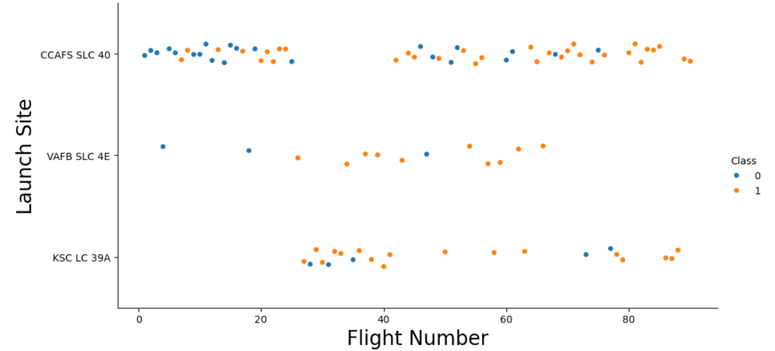
Flight Number vs. Launch Site
Class 0 (blue) represents unsuccessful launch, and Class 1 (orange) represents successful launch.
This figure shows that the success rate increased as the number of flights increased.
Likely a big breakthrough around flight 20 which significantly increased success rate. CCAFS appears to be the main launch site as it has the most volume.

Slide 24
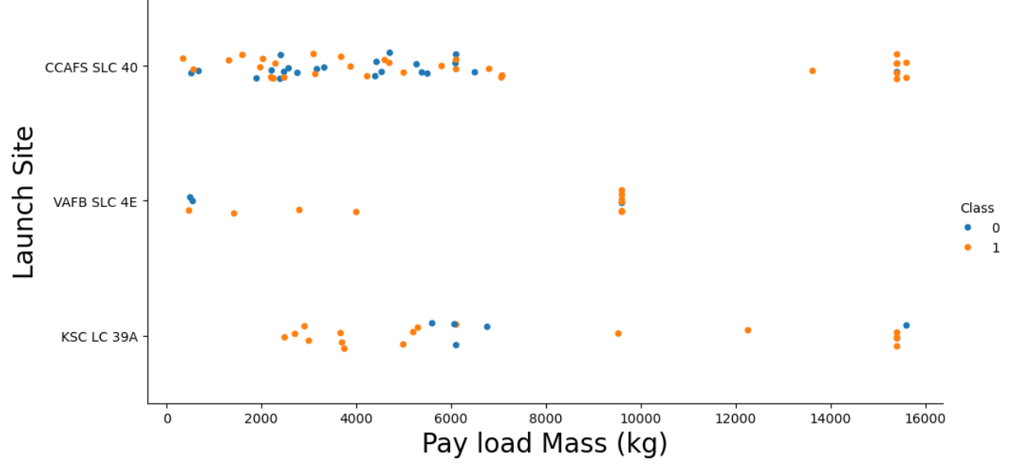
Launch Site vs. Payload Mass
Above a payload mass of around 7000 kg, there are very few unsuccessful landings, but there is also far less data for these heavier launches.
There is no clear correlation between payload mass and success rate for a given launch site.
All sites launched a variety of payload masses, with most of the launches from CCAFS SLC 40 being comparatively lighter payloads (with some outliers).

Slide 25
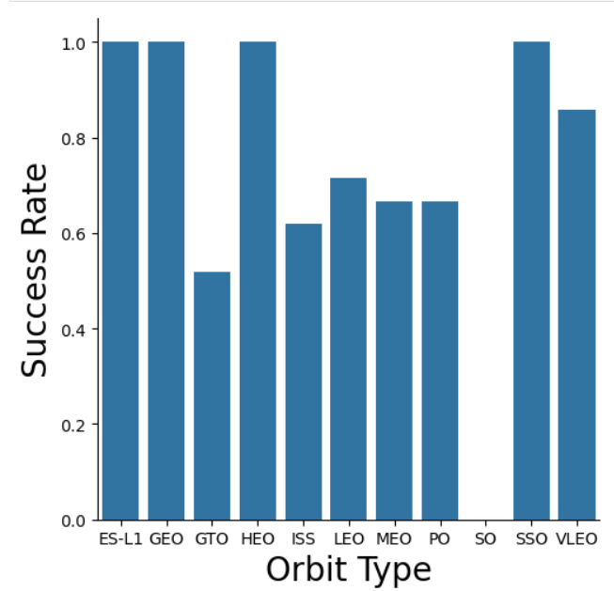
Success Rate vs. Orbit Type
The bar chart of Success Rate vs. Orbit Type shows that the following orbits have the highest (100%) success rate:
ES-L1 (Earth-Sun First Lagrangian Point)
GEO (Geostationary Orbit)
HEO (High Earth Orbit)
SSO (Sun-synchronous Orbit)
The orbit with the lowest (0%) success rate is:
SO (Heliocentric Orbit)

Slide 26
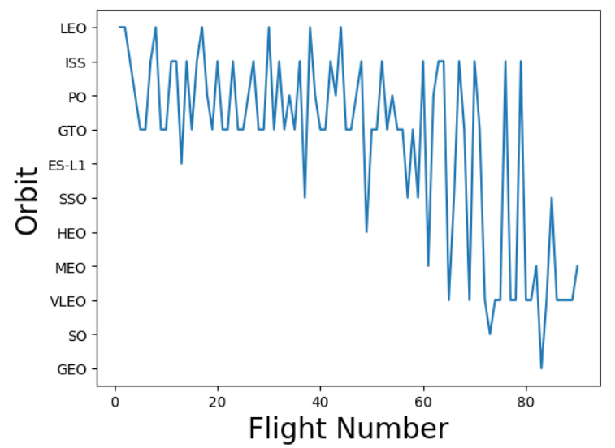
Flight Number vs. Orbit Type
The 100% success rate of GEO, HEO, and ES-L1 orbits can be explained by only having 1 flight into the respective orbits.
The 100% success rate in SSO is more impressive, with 5 successful flights.
There is little relationship between Flight Number and Success Rate for GTO.
Generally, as Flight Number increases, the success rate increases. This is most extreme for LEO, where unsuccessful landings only occurred for the low flight numbers (early launches).

Slide 27
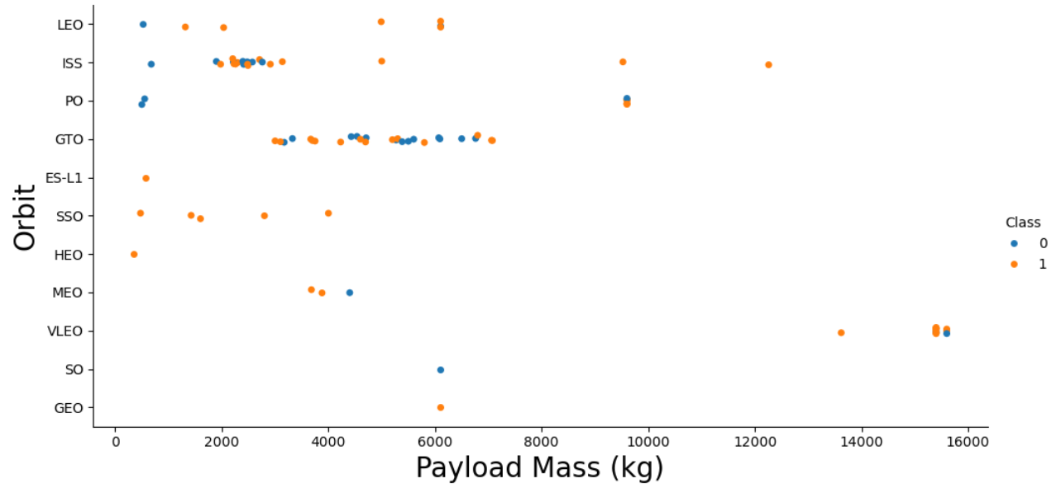
Orbit Type vs. Payload Mass
Class 0 (blue) represents unsuccessful launch, and Class 1 (orange) represents successful launch.
Payload mass seems to correlate with orbit LEO and SSO seem to have relatively low payload mass
The other most successful orbit VLEO only has payload mass values in the higher end of the range

Slide 28
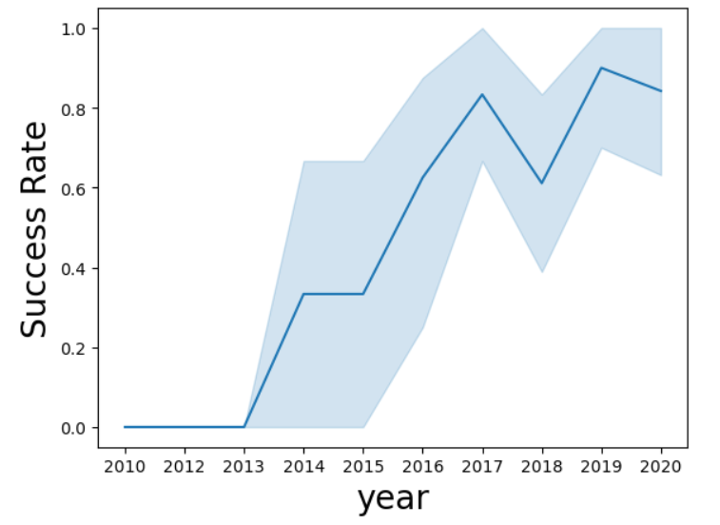
Launch Success Yearly Trend
Between 2010 and 2013, all landings were unsuccessful (as the success rate is 0).
After 2013, the success rate generally increased, despite small dips in 2018 and 2020.
After 2016, there was always a greater than 50% chance of success.

Slide 29
EDA WITH SQL

Slide 30
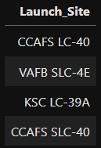
Display the names of the unique launch sites in the space mission
Query:
The key word DISTINCT to show only unique launch sites from the SpaceX data.
Result:

Slide 31
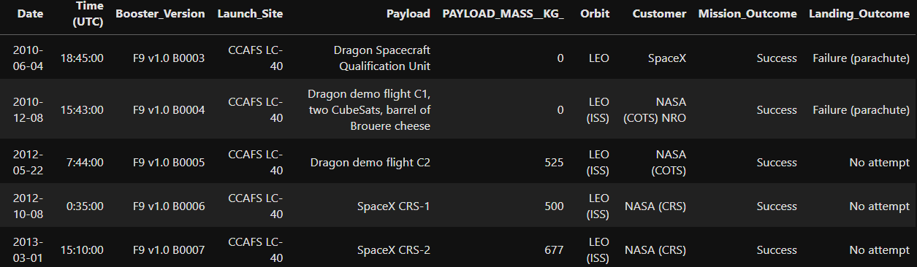
Display launch sites begin with the string ‘CCA’
Query:
Only five records of the SpaceX table were displayed using LIMIT 5 clause in the query
Result:

Slide 32
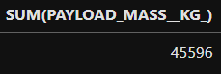
The Total Payload Mass carried by boosters launched by NASA(CRS)
Query:
The SUM keyword is used to calculate the total of the LAUNCH column, and the SUM keyword (and the associated condition) filters the results to only boosters from NASA (CRS).
Result:

Slide 33
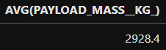
Average Payload Mass carried by booster version F9 v1.1
Query:
This query calculates the average payload mass or launches which used booster version F9 v1.1.
Average payload mass of F9 1.1 is on the low end of our payload mass range
Result:

Slide 34

List the date when first successful landing outcome in ground pad was achieved
Query:
The MIN keyword is used to calculate the minimum of the DATE column, i.e. the first date, and the WHERE keyword (and the associated condition) filters the results to only the successful ground pad landings.
Result:

Slide 35
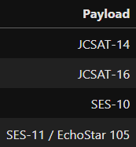
Successful Drone Ship Landing with Payload between 4000 and 6000
Query:
Result:
We used the WHERE clause to filter for boosters which have successfully landed on drone ship and applied the AND condition to determine successful landing with payload mass greater than 4000 but less than 6000

Slide 36
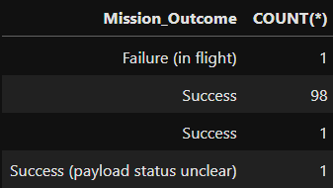
Total Number of Successful and Failure Mission Outcomes
Query:
This query returns a count of each mission outcome.
SpaceX appears to achieve its mission outcome nearly 98% of the time.
This means that most of the landing failures are intended.
Interestingly, one launch has an unclear payload status and unfortunately one failed in flight
Result:

Slide 37
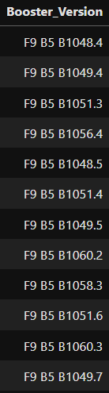
Boosters Carried Maximum Payload
Query:
Result:
A subquery is used here.
The SELECT statement within the brackets finds the maximum payload, and this value is used in the WHERE condition.
The DISTINCT keyword is then used to retrieve only distinct /unique booster versions.

Slide 38
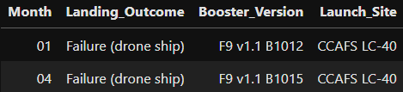
2015 Launch Records
Query:
This query returns the Month, Landing Outcome, Booster Version, Payload Mass (kg), and Launch site of 2015 launches where stage 1 failed to land on a drone ship.
There were two such occurrences. List the failed landing_outcomes in drone ship, their booster versions, and launch site names for in year 2015.
In 2015, there were two landing failures on drone ships.
Result:

Slide 39
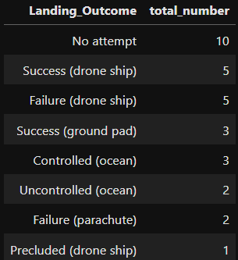
Rank Landing Outcomes Between 2010-06-04 and 2017-03-20
Query:
Result:
This query returns a list of successful landings and between 2010-06-04 and 2017-03-20 inclusively.
There are two types of successful landing outcomes: drone ship and ground pad landings.
There were 8 successful landings in total during this time period

Slide 40
LAUNCH SITES PROXIMITY ANALYSIS – FOLIUM INTERACTIVE MAP

Slide 41
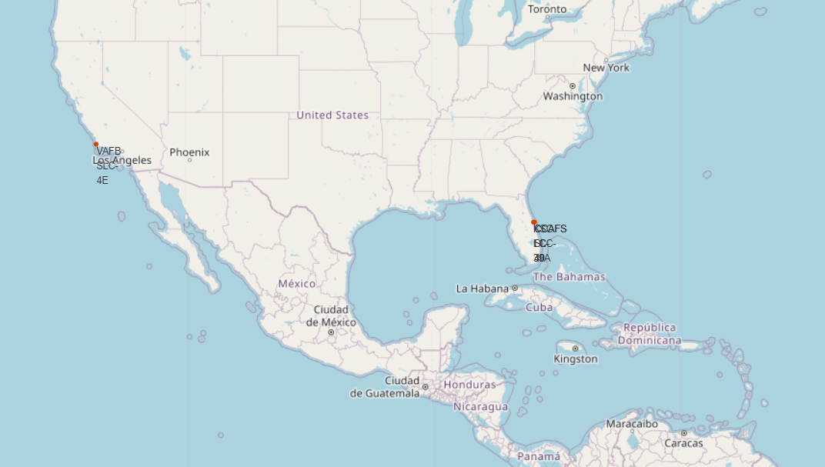

All launch sites on a map
The left map shows all SpaceX launch sites, and the right map also shows that all launch sites are in the United States.
As can be seen on the map, all launch sites are near the coast.

Slide 42
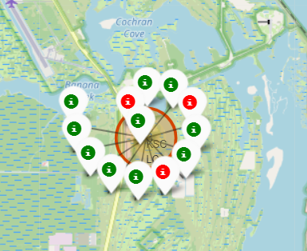
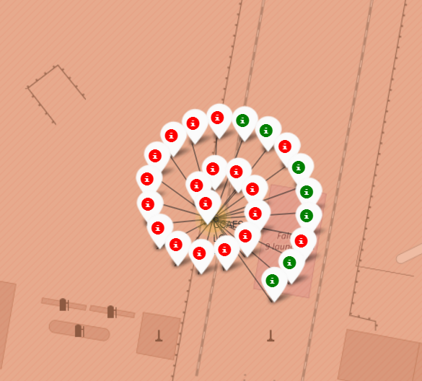
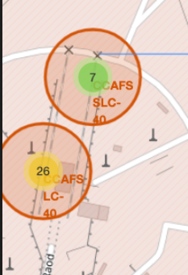
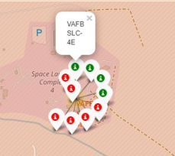
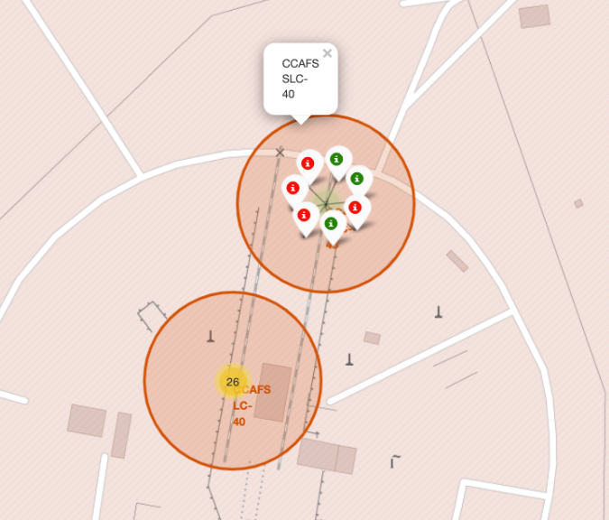
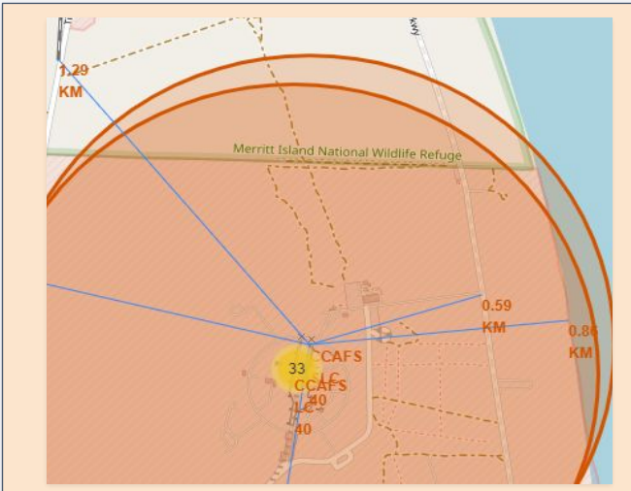
Color-labeled Launch Outcomes
Launch Site in California
Launch Sites in Florida
Launches have been grouped into clusters, and annotated with green icons for successful launches, and red icons for failed launches.

Slide 43
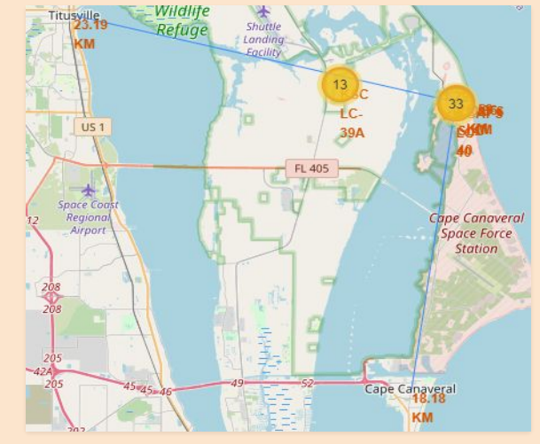
Proximities of Launch Sites
• It can be found that the launch site is close to railways and highways for transportation of equipment or personnel, and is also close to coastline and relatively far from the cities so that launch failure does not pose a threat.

Slide 44
BUILD AN INTERACTIVE DASHBOARD
- PLOTLY DASH

Slide 45
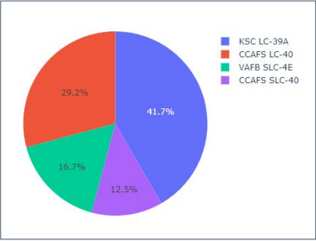
Total Success Launches By all sites
Pie chart showing the success percentage achieved by each launch site
The launch site KSC LC-39 A had the most successful launches, with 41.7% of the total successful launches

Slide 46

Launch Site with Highest Launch Success Ratio
Pie chart showing the Launch site with the highest launch success ratio
Launch Success Ratio Total Success Launched for site KSC LC-39A Success Failure.
KSLC-39A has the highest success rate with 10 landing successes (76.9%) and 3 landing failures (23.1%).
Launch Success Ratio Total Success Launched for site KSC LC-39A Success Failure
KSLC-39A has the highest success rate with 10 landing successes (76.9%) and 3 landing failures (23.1%).

Slide 47

Launch Outcome Vs. Payload scatter plot for all sites
Plotting the launch outcome vs. payload for all sites shows a gap around 4000 kg, so it makes sense to split the data into 2 ranges:
0 – 4000 kg (low payloads)
4000 – 10000 kg (massive payloads)
From these 2 plots, it can be shown that the success for massive payloads is lower than that for low payloads.
It is also worth noting that some booster types (v1.0 and B5) have not been launched with massive payloads.
These figures show that the launch success rate (class 1) for low weighted payloads(0-5000 kg) is higher than that of heavy weighted payloads(5000-10000 kg).

Slide 48
PREDICTIVE ANALYSIS - CLASSIFICATION

Slide 49



Classification Accuracy
Plotting the Accuracy Score and Best Score for each classification algorithm produces the following result:
The Decision Tree model has the highest classification accuracy
The Accuracy Score is 94.44%
The Best Score is 90.36%

Slide 50

Confusion Matrix
The confusion matrix for the decision tree classifier shows that the classifier can distinguish between the different classes.
The major problem is the false positives .i.e., unsuccessful landing marked as successful landing by the classifier.
The models predicted 12 successful landings when the true label was successful and 3 failed landings when the true label was failure. But there were also 3 predictions that said successful landings when the true label was failure (false positive).
Overall, these models predict successful landings.

Slide 51
CONCLUSION

Slide 52
Conclusions
As the number of flights increased, the success rate increased, and recently it has exceeded 80%.
Orbital types SSO, HEO, GEO, and ES-L1 have the highest success rate (100%).
The launch site is close to railways, highways, and coastline, but far from cities.
The launch site KSC LC-39 A had the most successful launches, with 41.7% of the total successful launches, and also the highest rate of successful launches, with a 76.9% success rate.
The launch success for massive payloads (over 4000kg) is lower than that for low payloads.
In this dataset, all models have the same accuracy (83.33%), but it seems that more data is needed to determine the optimal model due to the small data size.

Slide 53
APPENDIX

Slide 54
Appendix
Git Hub Link:
https://github.com/ashashet/Data-Science-Project
Coursea:
https://www.coursera.org/professional-certificates/ibm-data-science

